Slide 1
Functions: breaking big problems into small pieces
f( )
PROGRAMMING FUNDAMENTALS · WEEK 3 · LECTURE 1
Why we need functions, the two families of functions, and writing our very first one
Lecture 1 of 2 · 60 minutes
Notes:
Welcome the class. Do not define “function” yet. Ask: “Who has written a program that got so long you got lost in it?” Let a few students answer. Tell them: today we learn the tool every real programmer uses to keep programs small and organised. Say that by the end of the hour they will write their own function.

Slide 2
Six steps
TODAY’S PLAN
What we do: Warm-up: a long, repetitive program Why functions? Need, importance, divide and conquer Reusability; predefined vs user-defined functions First function, return type, parameters, memory video Void functions vs value-returning functions Quick check, recap and homework
Notes:
Show the plan quickly (1 minute). Tell students there will be a quick check at the end, so they should stay with you. Keep a timer visible if you can; the first lecture usually overruns in the “why” part, so watch the 20-minute mark.

Slide 3
Write a program that prints this
WARM-UP · 2 MINUTES
**********
Welcome to the Result System
**********
Enter your marks below
**********
Thank you!
**********
Use only what you already know: cout and loops.
Count how many times you write the same lines.
Then imagine your teacher says: “Make every line 20 stars instead of 10.”
Notes:
Give students 2 minutes to write it in their notebooks. Walk around. Most will write the loop that prints a star line four times. Ask one student to read their answer aloud. Then ask: “How many places would you change to make the lines 20 stars long?” Answer: four. Move to the next slide.

Slide 4
What most of us write
THE PROBLEM
int main() {
for (int i = 0; i < 10; i++) cout << '*';
cout << endl;
cout << "Welcome to the Result System\n";
for (int i = 0; i < 10; i++) cout << '*';
cout << endl;
cout << "Enter your marks below\n";
for (int i = 0; i < 10; i++) cout << '*';
cout << endl;
cout << "Thank you!\n";
for (int i = 0; i < 10; i++) cout << '*';
cout << endl;
}
The same 2 lines are written 4 times
20 stars? Change 4 places
Forget one place and the output is wrong
Now imagine a program of 2,000 lines
Notes:
Point at the repeated lines. Say: this works, but it is fragile. Real programs are thousands of lines long. If one job is copied 50 times and it has a bug, we must fix it 50 times. Ask: “Wouldn’t it be nice to write the star-line code ONCE, give it a name, and just say the name whenever we need it?” That idea is a function.

Slide 5



Think of a restaurant kitchen
REAL-LIFE PICTURE
Head chef = main()
Helper = function
Order = function call
Does not cook everything alone. Gives orders and puts the meal together.
Has one job only: make the sauce, cut the onions, bake the naan.
“Make sauce!” The helper does the job and hands back the result.
The chef does not care how the sauce is made, only that it comes back ready.
Notes:
Use any local example the students relate to: a wedding where one person handles food, one handles decoration, one handles guests; or a cricket team where each player has a role. Key message: a big job goes smoothly when it is split among helpers who each do ONE thing. In C++, main() is the head chef and functions are the helpers.

Slide 6

A function is a named block of code that does one specific job. Write it once, run it whenever you call its name.
DEFINITION
INPUT
FUNCTION
OUTPUT
Values we give it
Does the job
Result it gives back
5
square
25
Notes:
Read the definition slowly and ask two students to repeat it in their own words. Draw the input–process–output picture on the board too. Mention that some functions take no input and some give no output; we will see both today. The “machine” idea works well: you put something in, the machine does its work, something comes out.

Slide 7
Why do we need functions?
NEED AND IMPORTANCE
Less repetition
Easier to read
Easier to fix
Write the code once, use it many times.
main() reads like a short to-do list.
A bug lives in one small place, fixed once.
Easier to test
Teamwork
Reusable
Check each small piece on its own.
Different people write different functions.
Copy a good function into your next program.
Notes:
Go card by card, linking each back to the warm-up program: less repetition (4 copies became 1), easier to fix (change 10 to 20 in one place), easier to read (main says printLine instead of a loop). For teamwork: in a software company one person writes login, another writes payment. Ask the class which benefit they think matters most.

Slide 8
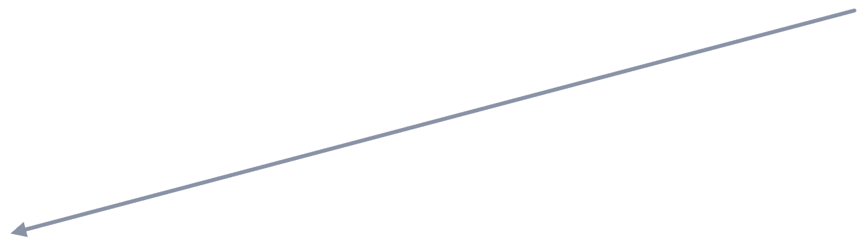
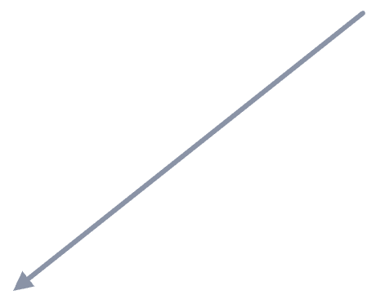
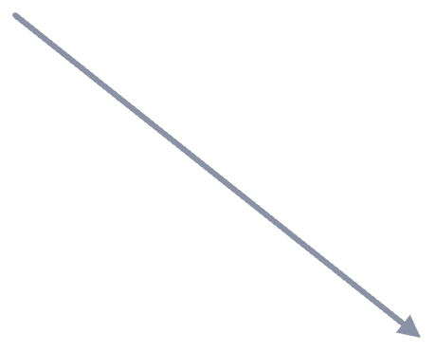
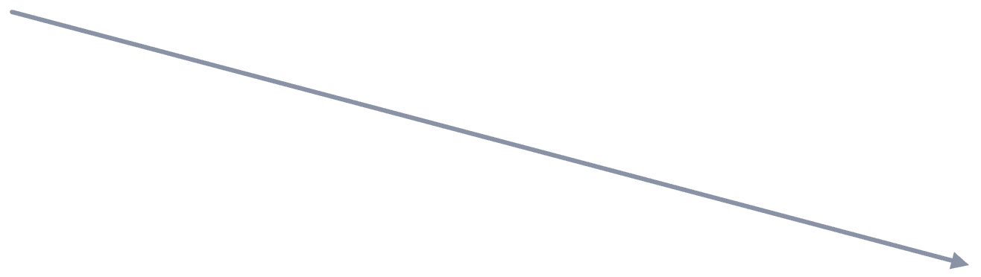
Split one big problem into small ones
DIVIDE AND CONQUER
Student Result System
getMarks()
calcTotal()
calcGrade()
printResult()
Read the marks
Add them up
Decide A, B, C or F
Show the report card
Big problem → small problems → each one solved by a function → main() just calls them in order.
Notes:
Explain “divide and conquer”: an old military idea — you can’t defeat a big army at once, so you split it and defeat each part. In programming we can’t solve a big problem at once, so we split it into small problems that are each easy. Ask the class: “If you were building an ATM program, which small functions would you need?” Collect answers on the board: checkPin, showBalance, withdraw, deposit, printReceipt.

Slide 9
Write once, call many times
REUSABILITY
void printLine() {
for (int i = 0; i < 10; i++)
cout << '*';
cout << endl;
}
int main() {
printLine();
cout << "Welcome to the Result System\n";
printLine();
cout << "Enter your marks below\n";
printLine();
cout << "Thank you!\n";
printLine();
}
The star line is written once
It is used 4 times by name
20 stars? Change one number
main() now reads like plain English
Notes:
Put this side by side with the earlier program (go back one slide if needed). Same output, but now the loop exists only once. Don’t explain every part of the syntax yet; just say: “void printLine() is the name tag, the part in curly braces is the job, and printLine(); is how we ask for the job to be done.” We will look at every part properly in 10 minutes.

Slide 10
Predefined vs user-defined functions
TWO FAMILIES
Predefined (built-in)
User-defined
Already written for us by C++ and kept in libraries. We include the header file and call them.
Written by us, the programmers, to do a job that our own program needs.
sqrt() pow() abs()
toupper() rand()
printLine() calcGrade()
findMax() isEven()
Notes:
Simple rule for students: if you did not write it and you got it by #include, it is predefined. If you wrote it yourself, it is user-defined. Remind them they have already used predefined functions without knowing it — main() itself is a function we write, and things like sqrt or getline are library functions.

Slide 11
Some you will use all the time
PREDEFINED FUNCTIONS
Function | Header | What it does | Example → result
sqrt(x) | <cmath> | Square root | sqrt(25) → 5
pow(x, y) | <cmath> | x to the power y | pow(2, 3) → 8
abs(x) | <cstdlib> | Absolute value | abs(-7) → 7
toupper(c) | <cctype> | Small letter to capital | toupper('a') → 'A'
isdigit(c) | <cctype> | Is it a digit? | isdigit('7') → true
rand() | <cstdlib> | A random number | rand() → e.g. 41
We call them and use the answer. We never see their code. That is the power of a function.
Notes:
Point out the pattern in every row: a NAME, something we GIVE it in the brackets, and something it GIVES BACK. Ask: “Do you know how sqrt calculates the root inside?” No — and we don’t need to. That idea (use it without knowing the inside) is called abstraction. Strictly, isdigit returns a non-zero int for true; “true” is fine at this level.

Slide 12
Using predefined functions
LIVE DEMO
#include <iostream>
#include <cmath>
using namespace std;
int main() {
double side = 9;
cout << sqrt(side) << endl; // 3
cout << pow(2, 10) << endl; // 1024
cout << abs(-15) << endl; // 15
return 0;
}
To use sqrt we only needed to know three things:
1. Its name
2. What to give it
3. What it gives back
Our own functions will be designed the same way.
Notes:
Type and run this in the IDE in front of the class — running real code builds confidence. Then remove “#include <cmath>” and compile again so they see the error: the compiler doesn’t know sqrt. Lesson: a predefined function needs its header file. Put the include back.

Slide 13
Our very first function
USER-DEFINED FUNCTION
#include <iostream>
using namespace std;
void sayHello() { // the function
cout << "Hello, students!" << endl;
}
int main() {
cout << "Program starts" << endl;
sayHello(); // call it
sayHello(); // call it again
cout << "Program ends" << endl;
return 0;
}
OUTPUT
Program starts
Hello, students!
Hello, students!
Program ends
Written once, ran twice.
Notes:
Type this live. Before running, ask the class to predict the output and write it down. Then run. Ask: “Why does Hello appear twice when we wrote the cout only once?” Then try: delete one of the calls and run — Hello appears once. Delete both calls — the function is still there but never runs. A function only runs when it is called.

Slide 14
The four parts of every function
ANATOMY
int square (int n)
{
return n * n;
}
1. Return type
2. Name
3. Parameters
4. Body
What comes back: int
How we call it: square
What goes in, inside ( )
The job, inside { }
Notes:
Match each colour in the code to its card. Parts 1–3 together form the function HEADER (first line); part 4 is the BODY. Naming rules are the same as variable names: no spaces, can’t start with a digit, use meaningful verbs (calcTotal, printLine). If a function needs no input, the brackets are still written but left empty: sayHello().

Slide 15

What does the function hand back?
PART 1 · RETURN TYPE
Return type | What comes back | Example header
int | A whole number | int square(int n)
double | A decimal number | double average(…)
char | One character | char grade(…)
bool | true or false | bool isEven(int n)
void | Nothing at all | void printLine()
You give a shopkeeper money and get change back. You put a coin in a juice machine and get juice back.
The return type tells us what kind of thing comes back from a function.
The return statement does the handing back: return n * n; sends the answer to the caller and ends the function. The answer must match the return type.
Notes:
Spend time here; this is the idea beginners struggle with most. Ask: “If I ask a function for someone’s grade, what type comes back?” (char). “For the average of marks?” (double). “For whether a number is even?” (bool). “For printing a line of stars?” (nothing, so void). Students often confuse return with cout: cout shows a value on the screen for the user; return hands a value back to the program so it can be stored or used.

Slide 16
What does the function need?
PART 2 · PARAMETERS
A juice machine needs fruit. An ATM needs your card and the amount. A function may also need values to do its job. These inputs, written inside the ( ), are called parameters.
void printLine()
int square(int n)
Needs nothing: the brackets stay empty
Needs one whole number, called n
int add(int a, int b)
double area(double l, double w)
Needs two whole numbers, a and b
Needs two decimal numbers: length and width
Rule: each parameter is a type plus a name, separated by commas. Every parameter needs its own type: (int a, int b) correct, (int a, b) wrong.
Notes:
Tell students a parameter is just a variable that is declared inside the brackets instead of inside the body. It gets its value from whoever calls the function. Ask the class to say what each header needs, out loud, before revealing the explanation. Then ask: “What parameters would a function need to calculate the area of a circle?” (one double: the radius).

Slide 17

How a value goes in and an answer comes out
PARAMETERS AND RETURN TOGETHER
1 · The call
2 · Value goes in
3 · Body runs
4 · Answer back
square(5)
n = 5
return n*n;
→ 25
main asks: “the square of 5, please”
5 is placed into the parameter n
The job uses n: 5 × 5 = 25
The call square(5) is replaced by 25
Same function, new value: square(7) puts 7 into n and gives back 49. The parameter is the door in; return is the door out.
Notes:
Walk through the four boxes slowly, pointing at each. Then do the same with the class for square(3) and square(10), asking them to say each step aloud: “3 goes into n, the body calculates 9, 9 comes back.” The “door in / door out” picture is worth repeating: parameters bring values in, return sends one value out.

Slide 18
Design any function with 3 questions
PUTTING IT TOGETHER
Ask yourself | It gives you | Bigger of two numbers | Say hello n times
1. What job does it do? | The name | max | printHello
2. What does it need? | The parameters | (int a, int b) | (int times)
3. What does it give back? | The return type | int | void (nothing)
Header for example 1
Header for example 2
int max(int a, int b)
void printHello(int times)
Answer the three questions first, and the first line of the function writes itself.
Notes:
Do one more example with the class before moving on: “calculate the area of a rectangle”. Q1 name: area. Q2 needs: length and width, both double. Q3 gives back: a double. So: double area(double length, double width). Then ask them to design “check if a student passed” (bool passed(int marks)). This 3-question habit is what lets beginners write a header without fear.

Slide 19
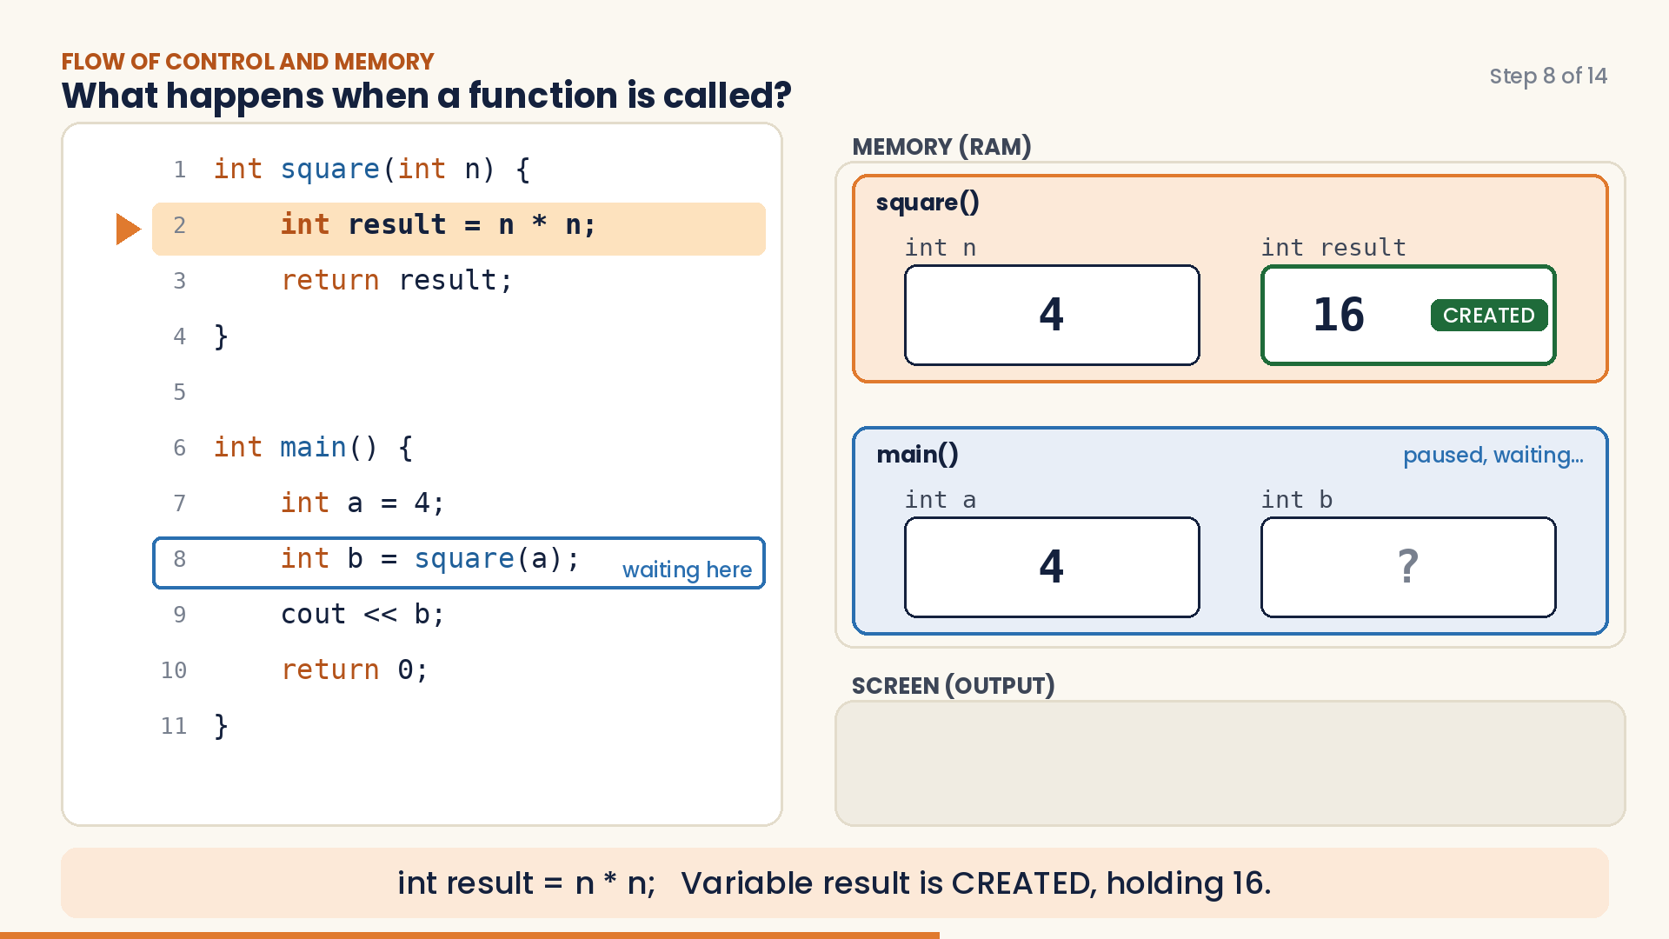
Watch what happens in memory
FLOW OF CONTROL · NARRATED VIDEO · 1½ MINUTES
WHAT TO LOOK FOR
Highlighted line: the line running now
JUMP: control goes into the function
RETURN: control and the answer come back
CREATED: a variable is born
DESTROYED: a variable dies
Notes:
The video starts by itself when this slide opens in Present mode; click it to pause or play (about 1½ minutes, with a spoken English narration and on-screen captions). Check the classroom speakers before the lecture. Play it once all the way through. Then play it again and pause at three moments to ask questions: (1) after “main() CALLS square(a)” — “Where will control go now?”; (2) after “COPIED into n” — “Is n the same box as a?” (no, a separate box with a copy); (3) after “DESTROYED” — “Can main() still use result?” (no, it no longer exists). The next slide has the same steps on paper for printing.

Slide 20
Variables are born and destroyed
THE VIDEO, STEP BY STEP
1 int square(int n) {
2 int result = n * n;
3 return result;
4 }
5
6 int main() {
7 int a = 4;
8 int b = square(a);
9 cout << b;
10 return 0;
11 }
Line | What happens | Memory now
6–7 | main starts; a created = 4 | main: a=4
8 | b created; main calls square(a) and waits | main: a=4, b=?
1 | n created; 4 copied into n | square: n=4
2 | result created = 16 | square: n=4, result=16
3–4 | 16 sent back; n and result destroyed | square: gone
8 | back in main: b = 16 | main: a=4, b=16
9 | 16 printed on screen | main: a=4, b=16
10–11 | main ends; a and b destroyed | empty
Notes:
This is the printable version of the video. Ask students to copy the table into their notebooks and redo it themselves with a = 7 (n becomes 7, result 49, b 49). Key sentence to repeat: a function’s variables (its parameters and the variables declared inside it) are created when the function is called and destroyed when it ends. That is why main() cannot use n or result.

Slide 21
Value-returning vs void
TWO KINDS OF USER-DEFINED FUNCTIONS
 | Value-returning | void
Gives a result back? | Yes, exactly one value | No, it just does a job
Return type | int, double, char, bool … | void
return statement | Must have return value; | Not needed
How we call it | Inside an expression: x = square(4); | As its own statement: printLine();
Real life | A calculator: you get an answer | A printer: it prints, gives nothing back
Notes:
This is the most important comparison of today. Use the real-life row: you ask a calculator something and it hands you an answer you can use; you send a page to a printer and it just does the job. Ask: “Is sqrt value-returning or void?” (value-returning). “Is printLine?” (void). Mention that a void function MAY use “return;” with no value to leave early, but it’s not required.

Slide 22
It hands an answer back
VALUE-RETURNING FUNCTION
int square(int n) {
return n * n; // sends the answer back
}
int main() {
int a = square(5); // store it
cout << square(3); // print it
if (square(4) > 10) // test it
cout << " big";
return 0;
}
The call square(5) is replaced by its answer, 25.
So we can store it, print it, or use it in a condition, like any number.
n is the parameter (the door in); return is the door out.
Notes:
Trace on the board: square(5) → n becomes 5 → return 25 → the call is replaced by 25 → a = 25. Then square(3) prints 9, square(4) is 16 which is greater than 10, so “ big” prints. Ask a student to change the function into cube. Stress: a value-returning function returns exactly ONE value and return also ends the function immediately.

Slide 23
It does a job and gives nothing back
VOID FUNCTION
void printStars(int count) {
for (int i = 0; i < count; i++)
cout << '*';
cout << endl;
}
int main() {
printStars(5); // *****
printStars(12); // ************
return 0;
}
Called alone, as its own statement.
Nothing comes back, so we never write x = printStars(5);
This is our printLine from earlier, made better: now it can print any number of stars.
Notes:
Connect back to the warm-up: the earlier printLine always printed 10 stars. By putting a value in the brackets, the same function prints 5, 12 or 20 stars — one function, many uses. Ask the class to predict the output of printStars(0) (an empty line) before you run it.

Slide 24
Common beginner mistakes
WATCH OUT
Wrong | Right | Why
cout << printStars(5); | printStars(5); | A void function gives nothing to print
square(5); | int s = square(5); | The answer was thrown away
int square(int n) { n * n; } | { return n * n; } | Forgot return: no answer comes back
sayHello; | sayHello(); | A call always needs ( )
void sayHello(); { … } | void sayHello() { … } | No semicolon after the header
Notes:
Show each mistake in the IDE if time allows; seeing the real compiler error message helps students recognise it later. The last one is the most common in the lab. Note that “square(5);” compiles without error but is useless — the answer is lost.

Slide 25
Answer in your notebook
QUICK CHECK · 4 MINUTES
Q1
Q2
Is sqrt() predefined or user-defined?
What is the return type of a function that returns nothing?
Q3
Q4
What does int cube(int n) give back when called as cube(2)?
Find the bug: cout << printLine(); where printLine is void
Notes:
Answers: Q1 predefined (from <cmath>). Q2 void. Q3 an int, the value 8. Q4 printLine is void and gives back nothing, so there is nothing for cout to print — call it alone: printLine(); Ask different students for each answer; if many get Q4 wrong, go back to the void vs value-returning slide.

Slide 26
Today in one slide
RECAP
1 A function is a named block of code that does one job
2 Divide and conquer: big problem → small functions
3 Reusability: write once, call many times
4 Predefined come from libraries; user-defined we write
5 Value-returning gives one answer; void just does a job
6 A call jumps into the function, then returns back
Notes:
Ask the class to read each point aloud together. Then ask one student: “In one sentence, why do programmers use functions?” A good answer mentions breaking the problem down and not repeating code.

Slide 27
Homework
PRACTICE BEFORE NEXT CLASS
1. Write void printBox() that prints a 3 × 5 rectangle of # signs. Call it twice from main().
2. Write int cube(int n) that returns n × n × n. Use a loop in main() to print the cubes of 1 to 5.
3. Write double average(int a, int b, int c). Read 3 numbers in main() and print their average.
4. Experiment: move any of your functions below main() and compile. Write down the error you get. We solve it first thing next class.
Notes:
Task 4 is deliberate: it creates the problem that function prototypes solve, so Lecture 2 opens with students already curious about it. Remind them that in task 3 the division needs a double (divide by 3.0), otherwise the average loses its decimal part.

